Slide 1
Funny Faces
Rembrandt’s Portraits and Self-portraits

Slide 2
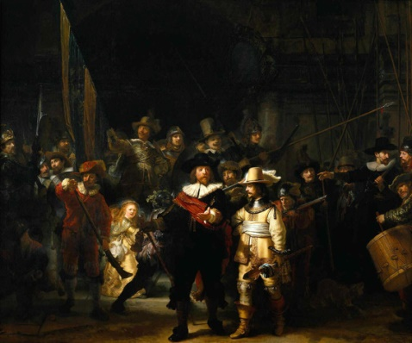
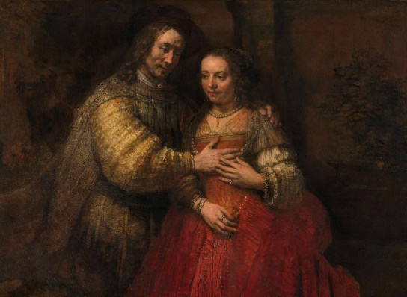
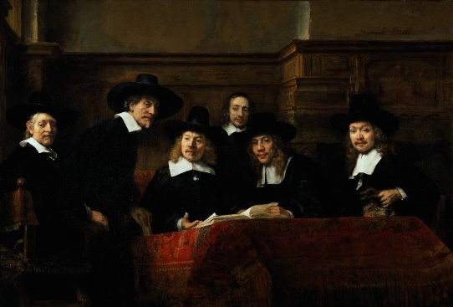
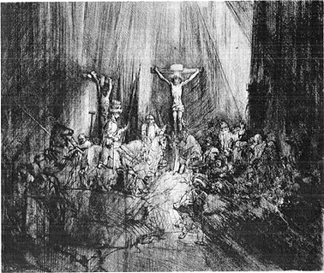
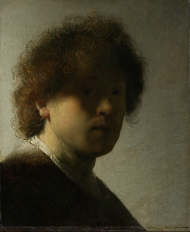
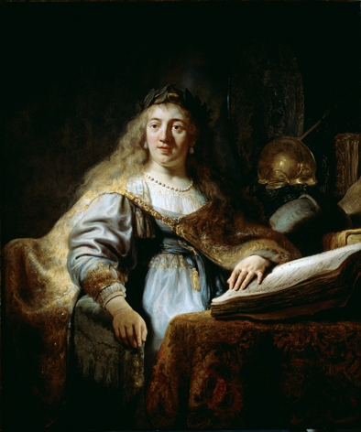
Works of art created by Rembrandt...

Slide 3
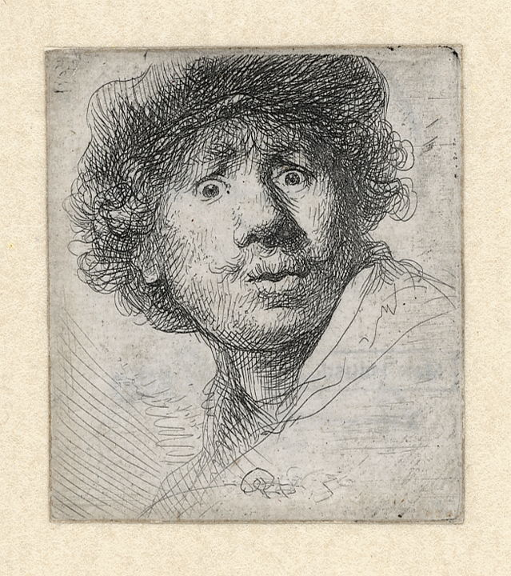
Rembrandt looked at his own face....
Rembrandt, Self-portrait looking surprised, 1630, etching

Slide 4
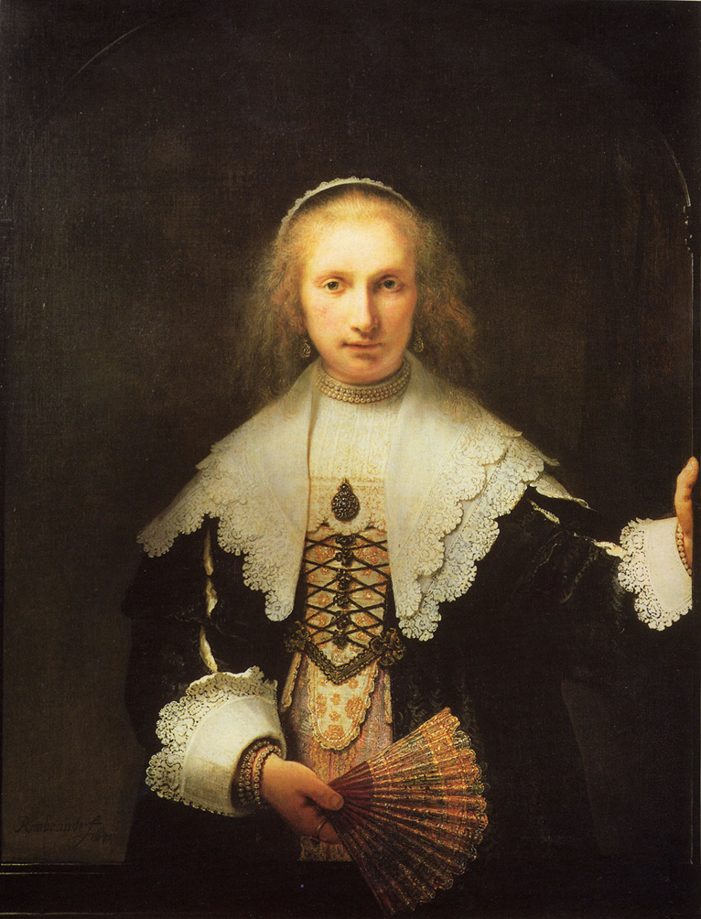
Rembrandt, Portrait of Agatha Bas, 1641, painting
Portrait of a rich woman

Slide 5
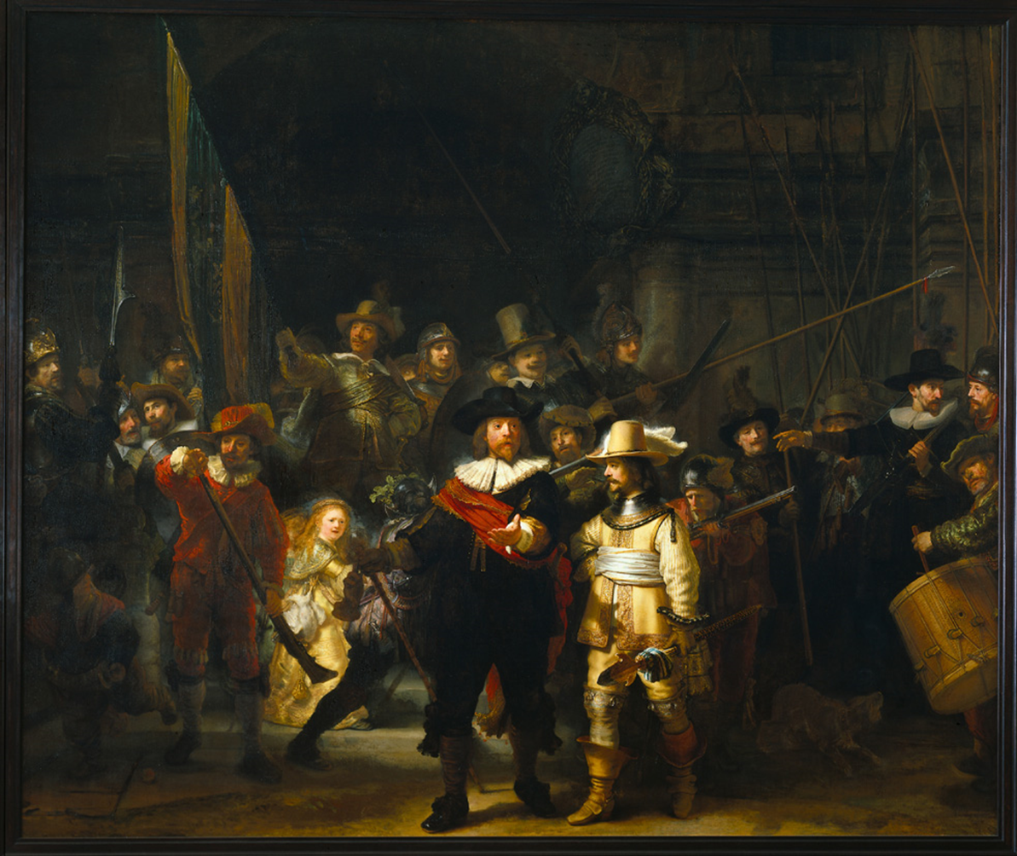
Rembrandt, The Night Watch, 1642, painting
A group portrait

Slide 6
This is a page from a manual from Rembrandt’s own day Here you see the guidelines artists used to draw a head

Slide 7
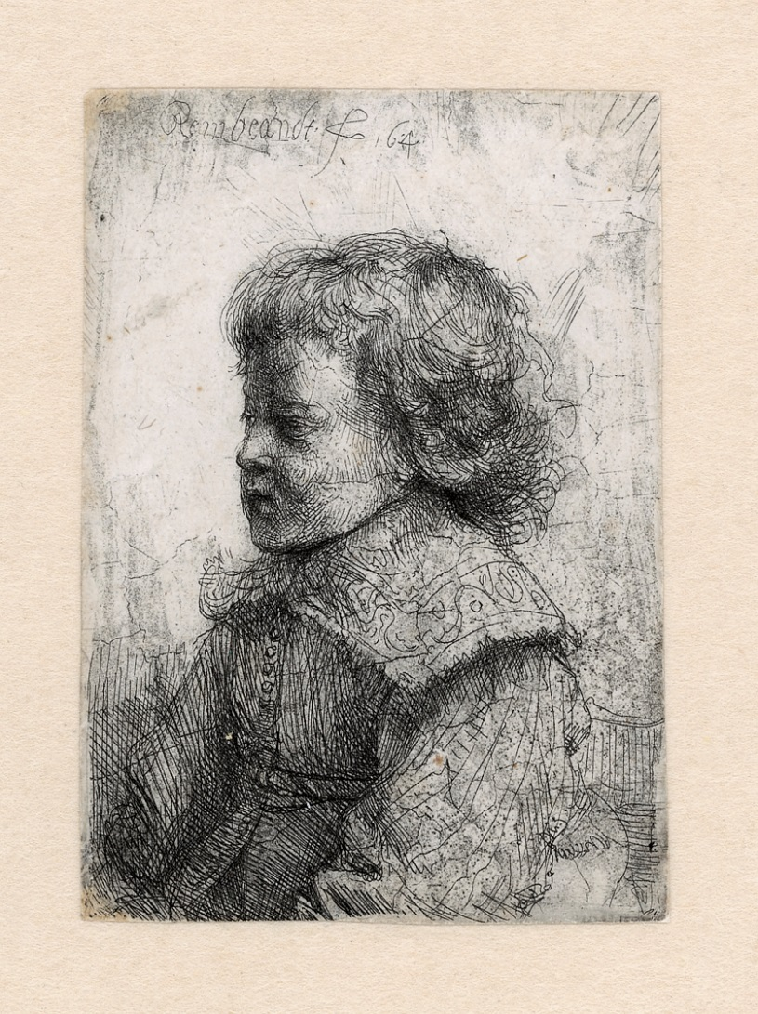
Rembrandt made etchings. What is that?
Rembrandt, Portrait of a boy, 1641, etching, 9 x 6 centimetres

Slide 8
Rembrandt, Self-portrait wearing a cap, grinning, 1630, etching
What does a laugh look like?

Slide 9
Rembrandt, Self-portrait, frowning, 1630, etching
An angry face

Slide 10
Rembrandt, Self-portrait with Saskia, 1636, etching
Rembrandt and Saskia

Slide 11
Rembrandt, Self-portrait with raised sabre, 1634, etching
Rembrandt in fancy dress

Slide 12
Rembrandt, Self-portrait sketching beside a window, 1648, etching
Rembrandt twice in reflection

Slide 13
Department of Education & Visitor Engagement

